Slide 1
06-Getting Connected (Chapter 2-3)

Slide 2













Link layer: introduction
terminology:
hosts and routers: nodes
communication channels that connect adjacent nodes along communication path: links
wired links
wireless links
LANs
layer-2 packet: frame, encapsulates datagram
global ISP
data-link layer has responsibility of
transferring datagram from one node
to physically adjacent node over a link

Slide 3
Link layer: context
datagram transferred by different link protocols over different links:
e.g., Ethernet on first link, frame relay on intermediate links, 802.11 on last link
each link protocol provides different services
e.g., may or may not provide rdt over link
transportation analogy:
trip from Princeton to Lausanne
limo: Princeton to JFK
plane: JFK to Geneva
train: Geneva to Lausanne
tourist = datagram
transport segment = communication link
transportation mode = link layer protocol
travel agent = routing algorithm

Slide 4
Link layer services
framing, link access:
encapsulate datagram into frame, adding header, trailer
channel access if shared medium
“MAC” addresses used in frame headers to identify source, dest
different from IP address!
reliable delivery between adjacent nodes
we learned how to do this already (chapter 3)!
seldom used on low bit-error link (fiber, some twisted pair)
wireless links: high error rates
Q: why both link-level and end-end reliability?

Slide 5
Link layer services (more)
flow control:
pacing between adjacent sending and receiving nodes
error detection:
errors caused by signal attenuation, noise.
receiver detects presence of errors:
signals sender for retransmission or drops frame
error correction:
receiver identifies and corrects bit error(s) without resorting to retransmission
half-duplex and full-duplex
with half duplex, nodes at both ends of link can transmit, but not at same time

Slide 6
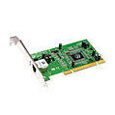
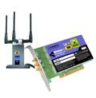

Where is the link layer implemented?
in each and every host
link layer implemented in “adaptor” (aka network interface card NIC) or on a chip
Ethernet card, 802.11 card; Ethernet chipset
implements link, physical layer
attaches into host’s system buses
combination of hardware, software, firmware
application
transport
network
link
cpu
memory
link
physical
host
bus
(e.g., PCI)
controller
physical
transmission
network adapter
card

Slide 7
Adaptors communicating
datagram
datagram
controller
controller
sending host
receiving host
datagram
frame
sending side:
encapsulates datagram in frame
adds error checking bits, rdt, flow control, etc.
receiving side
looks for errors, rdt, flow control, etc
extracts datagram, passes to upper layer at receiving side

Slide 8
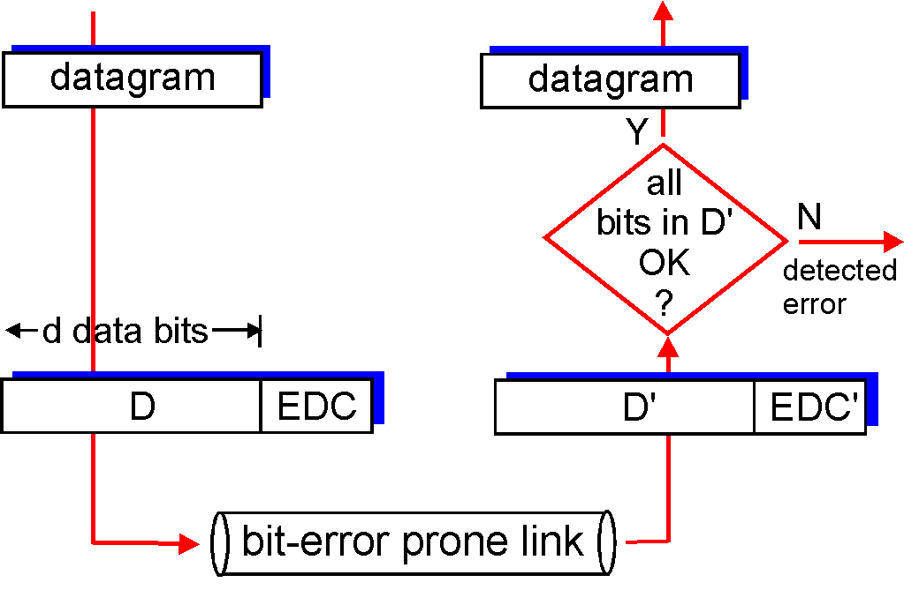
Error detection
EDC= Error Detection and Correction bits (redundancy)
D = Data protected by error checking, may include header fields
Error detection not 100% reliable!
protocol may miss some errors, but rarely
larger EDC field yields better detection and correction
otherwise

Slide 9
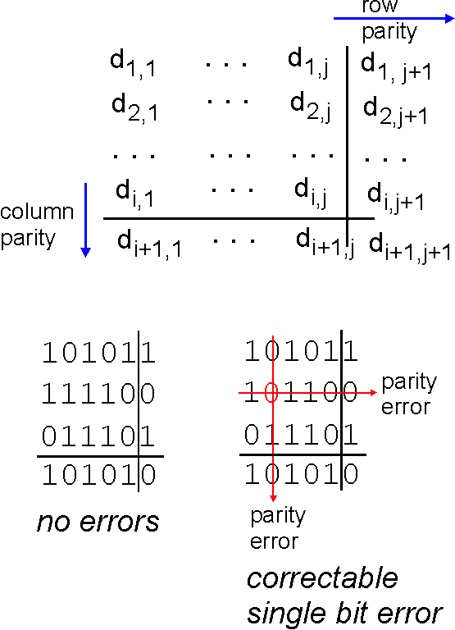
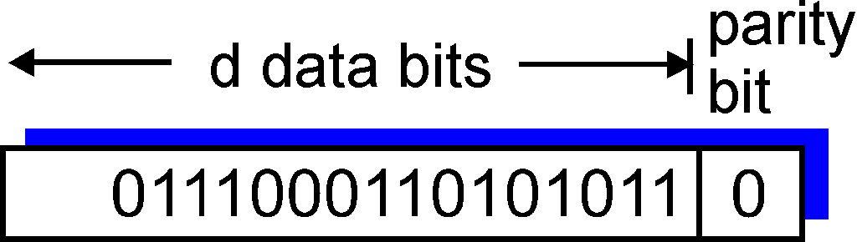
Parity checking
single bit parity:
detect single bit errors
two-dimensional bit parity:
detect and correct single bit errors
0
0

Slide 10
Internet checksum (review)
goal: detect “errors” (e.g., flipped bits) in transmitted packet (note: used at transport layer only)
sender:
treat segment contents as sequence of 16-bit integers
checksum: addition (1’s complement sum) of segment contents
sender puts checksum value into UDP checksum field
receiver:
compute checksum of received segment
check if computed checksum equals checksum field value:
NO - error detected
YES - no error detected. But maybe errors nonetheless?

Slide 11
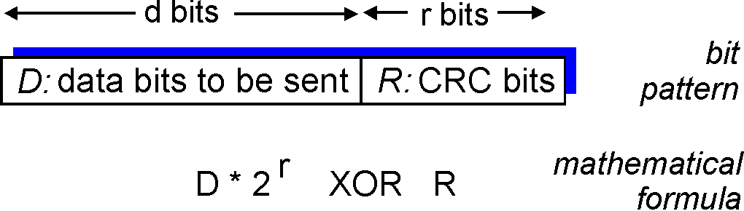
Cyclic redundancy check
more powerful error-detection coding
view data bits, D, as a binary number
choose r+1 bit pattern (generator), G
goal: choose r CRC bits, R, such that
<D,R> exactly divisible by G (modulo 2)
receiver knows G, divides <D,R> by G. If non-zero remainder: error detected!
can detect all burst errors less than r+1 bits
widely used in practice (Ethernet, 802.11 WiFi, ATM)

Slide 12
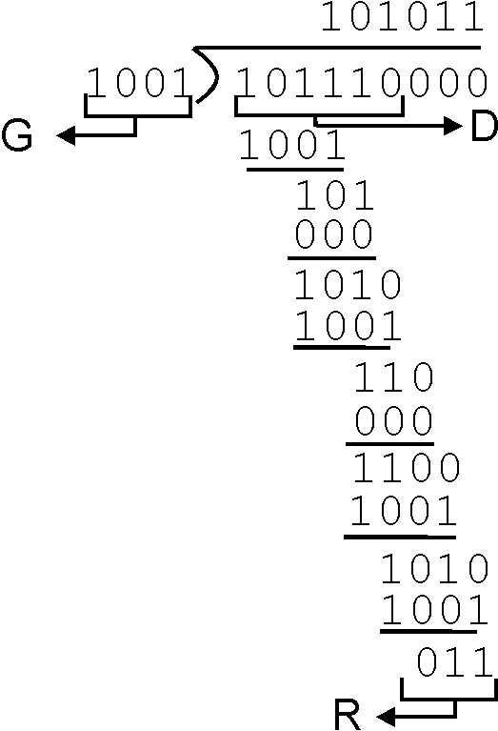
CRC example
want:
D.2^{r} XOR R = nG
equivalently:
D.2^{r} = nG XOR R
equivalently:
if we divide D.2^{r} by G, want remainder R to satisfy:
D.2^{r}
G
R = remainder[ ]

Slide 13


Multiple access links, protocols
two types of “links”:
point-to-point
PPP for dial-up access
point-to-point link between Ethernet switch, host
broadcast (shared wire or medium)
old-fashioned Ethernet
upstream HFC
802.11 wireless LAN
shared wire (e.g.,
cabled Ethernet)
shared RF
(e.g., 802.11 WiFi)
shared RF
(satellite)
humans at a
cocktail party
(shared air, acoustical)

Slide 14
Multiple access protocols
single shared broadcast channel
two or more simultaneous transmissions by nodes: interference
collision if node receives two or more signals at the same time
multiple access protocol
distributed algorithm that determines how nodes share channel, i.e., determine when node can transmit
communication about channel sharing must use channel itself!
no out-of-band channel for coordination

Slide 15
An ideal multiple access protocol
given: broadcast channel of rate R bps
desided:
1. when one node wants to transmit, it can send at rate R.
2. when M nodes want to transmit, each can send at average rate R/M
3. fully decentralized:
no special node to coordinate transmissions
no synchronization of clocks, slots
4. simple

Slide 16
MAC protocols: taxonomy
three broad classes:
channel partitioning
divide channel into smaller “pieces” (time slots, frequency, code)
allocate piece to node for exclusive use
random access
channel not divided, allow collisions
“recover” from collisions
“taking turns”
nodes take turns, but nodes with more to send can take longer turns

Slide 17
Channel partitioning MAC protocols: TDMA
TDMA: time division multiple access
access to channel in "rounds"
each station gets fixed length slot (length = pkt trans time) in each round
unused slots go idle
example: 6-station LAN, 1,3,4 have pkt, slots 2,5,6 idle
6-slot
frame
6-slot
frame
1
3
4
1
3
4

Slide 18
Channel partitioning MAC protocols: FDMA
FDMA: frequency division multiple access
channel spectrum divided into frequency bands
each station assigned fixed frequency band
unused transmission time in frequency bands go idle
example: 6-station LAN, 1,3,4 have pkt, frequency bands 2,5,6 idle
time
frequency bands
FDM cable

Slide 19
Random access protocols
when node has packet to send
transmit at full channel data rate R.
no a priori coordination among nodes
two or more transmitting nodes ➜ “collision”,
random access MAC protocol specifies:
how to detect collisions
how to recover from collisions (e.g., via delayed retransmissions)
examples of random access MAC protocols:
slotted ALOHA
ALOHA
CSMA, CSMA/CD, CSMA/CA

Slide 20
Slotted ALOHA
assumptions:
all frames same size
time divided into equal size slots (time to transmit 1 frame)
nodes start to transmit only slot beginning
nodes are synchronized
if 2 or more nodes transmit in slot, all nodes detect collision
operation:
when node obtains fresh frame, transmits in next slot
if no collision: node can send new frame in next slot
if collision: node retransmits frame in each subsequent slot with prob. p until success

Slide 21
Slotted ALOHA
node 1
1
1
1
1
node 2
2
2
2
node 3
3
3
3
C
E
C
S
E
C
E
S
S
Pros:
single active node can continuously transmit at full rate of channel
highly decentralized: only slots in nodes need to be in sync
simple
Cons:
collisions, wasting slots
idle slots
nodes may be able to detect collision in less than time to transmit packet
clock synchronization

Slide 22
Slotted ALOHA: efficiency
efficiency: long-run fraction of successful slots (many nodes, all with many frames to send)
max efficiency: find p* that maximizes Np(1-p)^{N-1}
for many nodes, take limit of Np*(1-p*)^{N-1} as N goes to infinity, gives:
max efficiency = 1/e = .37
suppose: N nodes with many frames to send, each transmits in slot with probability p
prob that given node has success in a slot = p(1-p)^{N-1}
prob that any node has a success = Np(1-p)^{N-1}
at best: channel
used for useful
transmissions 37%
of time!
!

Slide 23
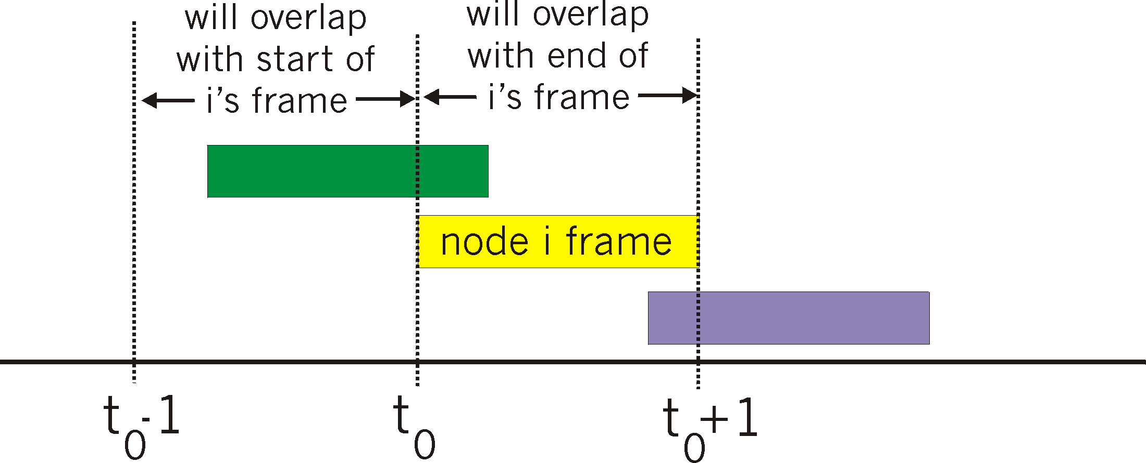
Pure (unslotted) ALOHA
unslotted Aloha: simpler, no synchronization
when frame first arrives
transmit immediately
collision probability increases:
frame sent at t₀ collides with other frames sent in [t₀-1,t₀+1]

Slide 24
Pure ALOHA efficiency
P(success by given node) = P(node transmits) .
P(no other node transmits in [t₀-1,t₀] .
P(no other node transmits in [t₀-1,t₀]
= p . (1-p)^{N-1 .} (1-p)^{N-1}
= p . (1-p)^{2(N-1)}
… choosing optimum p and then letting n
= 1/(2e) = .18
even worse than slotted Aloha!

Slide 25
CSMA (carrier sense multiple access)
CSMA: listen before transmit:
if channel sensed idle: transmit entire frame
if channel sensed busy, defer transmission
human analogy: don’t interrupt others!

Slide 26
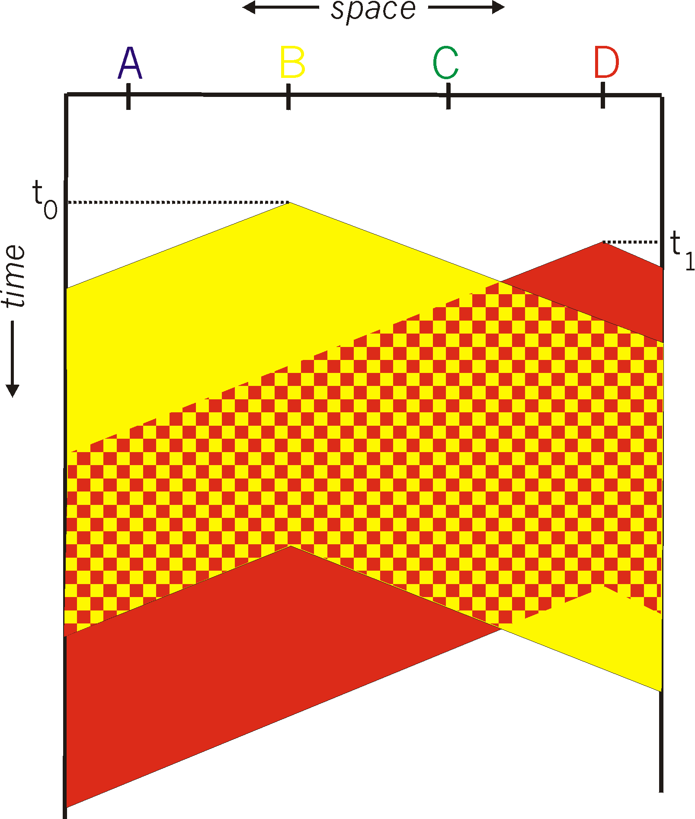
CSMA collisions
spatial layout of nodes
collisions can still occur: propagation delay means two nodes may not hear each other’s transmission
collision: entire packet transmission time wasted
distance & propagation delay play role in in determining collision probability

Slide 27
CSMA/CD (collision detection)
CSMA/CD: carrier sensing, deferral as in CSMA
collisions detected within short time
colliding transmissions aborted, reducing channel wastage
collision detection:
easy in wired LANs: measure signal strengths, compare transmitted, received signals
difficult in wireless LANs: received signal strength overwhelmed by local transmission strength
human analogy: the polite conversationalist

Slide 28
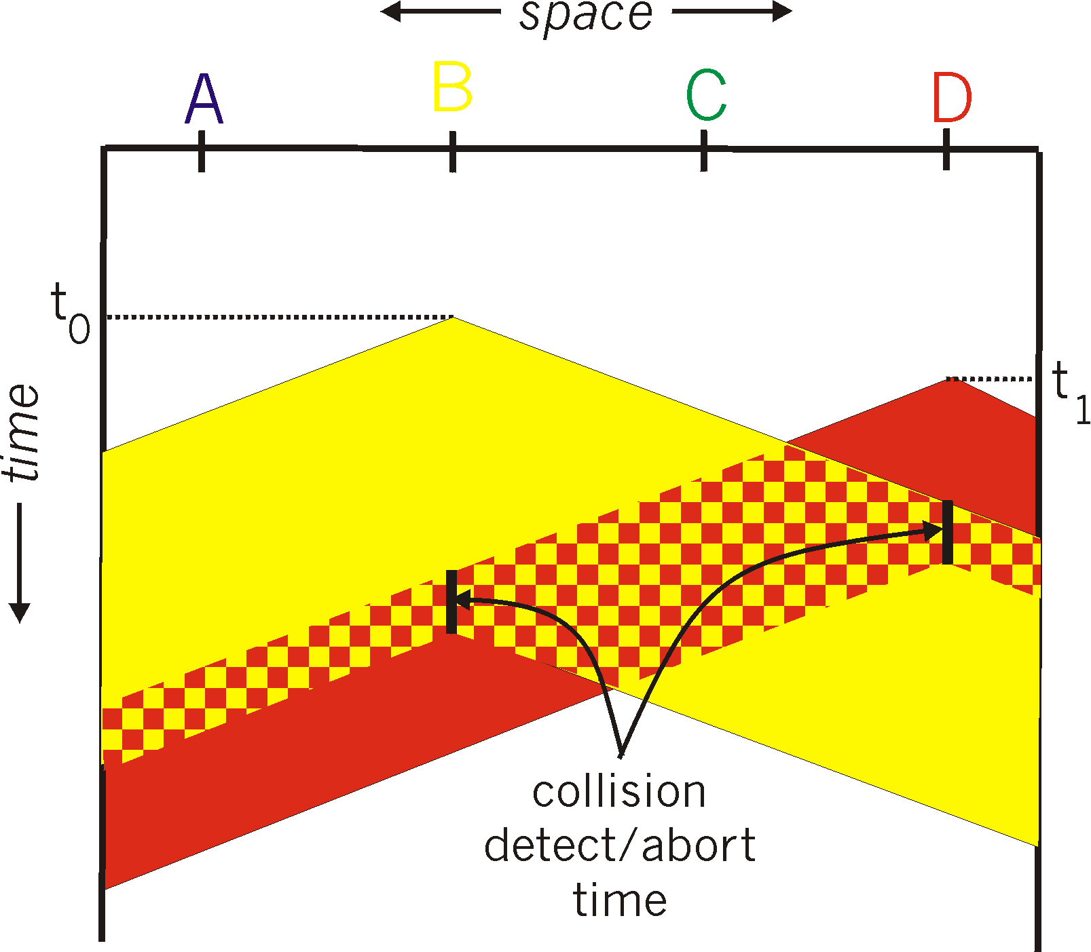
CSMA/CD (collision detection)
spatial layout of nodes

Slide 29
Ethernet CSMA/CD algorithm
1. NIC receives datagram from network layer, creates frame
2. If NIC senses channel idle, starts frame transmission. If NIC senses channel busy, waits until channel idle, then transmits.
3. If NIC transmits entire frame without detecting another transmission, NIC is done with frame !
4. If NIC detects another transmission while transmitting, aborts and sends jam signal
5. After aborting, NIC enters binary (exponential) backoff:
after mth collision, NIC chooses K at random from {0,1,2, …, 2^{m}-1}. NIC waits K·512 bit times, returns to Step 2
longer backoff interval with more collisions

Slide 30
CSMA/CD efficiency
T_{prop} = max prop delay between 2 nodes in LAN
t_{trans} = time to transmit max-size frame
efficiency goes to 1
as t_{prop} goes to 0
as t_{trans} goes to infinity
better performance than ALOHA: and simple, cheap, decentralized!

Slide 31
“Taking turns” MAC protocols
channel partitioning MAC protocols:
share channel efficiently and fairly at high load
inefficient at low load: delay in channel access, 1/N bandwidth allocated even if only 1 active node!
random access MAC protocols
efficient at low load: single node can fully utilize channel
high load: collision overhead
“taking turns” protocols
look for best of both worlds!

Slide 32
“Taking turns” MAC protocols
polling:
master node “invites” slave nodes to transmit in turn
typically used with “dumb” slave devices
concerns:
polling overhead
latency
single point of failure (master)
data
poll
master
data
slaves

Slide 33
“Taking turns” MAC protocols
token passing:
control token passed from one node to next sequentially.
token message
concerns:
token overhead
latency
single point of failure (token)
T
(nothing
to send)
T
data

Slide 34
Summary of MAC protocols
channel partitioning, by time, frequency or code
Time Division, Frequency Division
random access (dynamic),
ALOHA, S-ALOHA, CSMA, CSMA/CD
carrier sensing: easy in some technologies (wire), hard in others (wireless)
CSMA/CD used in Ethernet
CSMA/CA used in 802.11
taking turns
polling from central site, token passing
bluetooth, FDDI, token ring

Slide 35
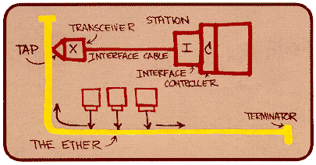
Ethernet
“dominant” wired LAN technology:
cheap $20 for NIC
first widely used LAN technology
simpler, cheaper than token LANs and ATM
kept up with speed race: 10 Mbps – 10 Gbps
Metcalfe’s Ethernet sketch

Slide 36


Ethernet: physical topology
bus: popular through mid 90s
all nodes in same collision domain (can collide with each other)
star: prevails today
active switch in center
each “spoke” runs a (separate) Ethernet protocol (nodes do not collide with each other)
switch
star
bus: coaxial cable

Slide 37
Ethernet frame structure
sending adapter encapsulates IP datagram (or other network layer protocol packet) in Ethernet frame
preamble:
7 bytes with pattern 10101010 followed by one byte with pattern 10101011
used to synchronize receiver, sender clock rates
type
preamble
dest.
address
source
address
data (payload)
CRC

Slide 38
Ethernet frame structure (more)
addresses: 6 byte source, destination MAC addresses
if adapter receives frame with matching destination address, or with broadcast address (e.g. ARP packet), it passes data in frame to network layer protocol
otherwise, adapter discards frame
type: indicates higher layer protocol (mostly IP but others possible, e.g., Novell IPX, AppleTalk)
CRC: cyclic redundancy check at receiver
error detected: frame is dropped
type
preamble
dest.
address
source
address
data (payload)
CRC

Slide 39
Ethernet: unreliable, connectionless
connectionless: no handshaking between sending and receiving NICs
unreliable: receiving NIC doesnt send acks or nacks to sending NIC
data in dropped frames recovered only if initial sender uses higher layer rdt (e.g., TCP), otherwise dropped data lost
Ethernet’s MAC protocol: unslotted CSMA/CD wth binary backoff

Slide 40
802.3 Ethernet standards: link & physical layers
many different Ethernet standards
common MAC protocol and frame format
different speeds: 2 Mbps, 10 Mbps, 100 Mbps, 1Gbps, 10G bps
different physical layer media: fiber, cable
application
transport
network
link
physical
MAC protocol
and frame format
100BASE-TX
100BASE-T2
100BASE-FX
100BASE-T4
100BASE-SX
100BASE-BX
copper (twister
pair) physical layer
fiber physical layer

